Slide 1


Slide 2



System Architecture
The system has three parts:
Desktop App
Webpage
Web Server
Notes:
Reasons for choice in solution:
To provide a centralized data collection point
To provide a common view space for all cameras
For easy setup
Provides a single medium of communication between the web server and the clients.
Allows for faster communication between the cameras and the apps since cameras are connected on a local network

Slide 3


Desktop App
Compatible with wired and wireless cameras
Supports HTTPS and RTSP protocols
Notes:
Reasons for choice in solution:
To provide a centralized data collection point
To provide a common view space for all cameras
For easy setup
Provides a single medium of communication between the web server and the clients.
Allows for faster communication between the cameras and the apps since cameras are connected on a local network

Slide 4
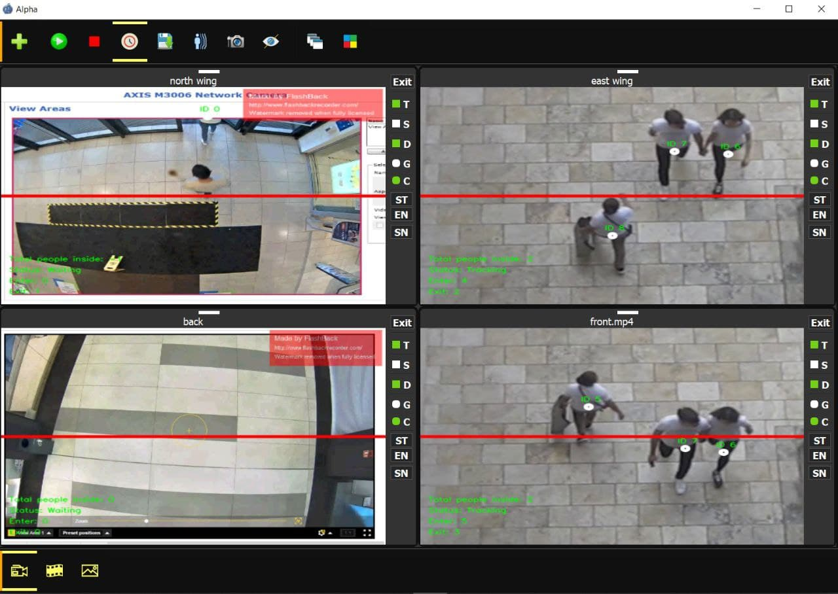
Desktop App

Slide 5

Desktop App Functionalities
Counts various individuals moving in and out of the building.
Saves surveillance videos for future reference.
Users can capture and save frames as pictures during surveillance.
Multiple cameras in the same view simultaneously.
Inbuilt video gallery, image gallery and a video player.
Processing of recorded videos from video files .
Sends frequent updates to the web server.
Exports saved videos and images.
Notes:
Reasons for choice in solution:
To provide a centralized data collection point
To provide a common view space for all cameras
For easy setup
Provides a single medium of communication between the web server and the clients.
Allows for faster communication between the cameras and the apps since cameras are connected on a local network

Slide 6


Webpage and Web Server
Stores data from the desktop app
Displays statistics of counted individuals
Notes:
Reasons for choice in solution:
To provide a centralized data collection point
To provide a common view space for all cameras
For easy setup
Provides a single medium of communication between the web server and the clients.
Allows for faster communication between the cameras and the apps since cameras are connected on a local network

Slide 7
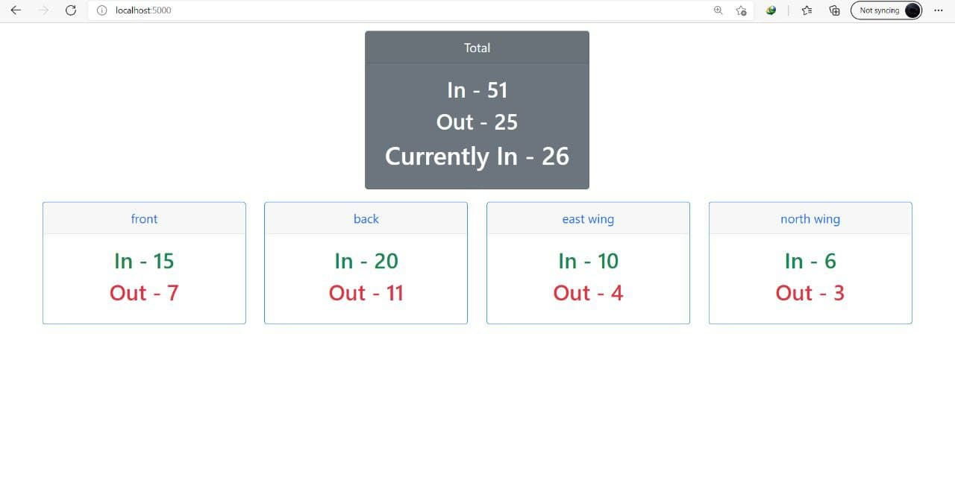
Web Interface

Slide 8

Business Model
Data from the system will be used to identify periods/seasons where there is high human traffic in and out of the building or shop.
This will help management in deciding when to import more products and services to satisfy their clients.
The system helps to control overcrowding, especially in times of pandemics such as COVID-19.
Notes:
Reasons for choice in solution:
To provide a centralized data collection point
To provide a common view space for all cameras
For easy setup
Provides a single medium of communication between the web server and the clients.
Allows for faster communication between the cameras and the apps since cameras are connected on a local network

Slide 9

Future Works
The system will;
Provide daily, weekly and monthly statistics in order to know the nature of traffic at the premises.
Export daily statistics via csv or xls.
Allow managers to control desktop app from remote locations via the web interface.
Automate and set application runtime to open hours only.
Rely on data from application to enforce the number of people that can be admitted in a building or shop.
Notes:
Reasons for choice in solution:
To provide a centralized data collection point
To provide a common view space for all cameras
For easy setup
Provides a single medium of communication between the web server and the clients.
Allows for faster communication between the cameras and the apps since cameras are connected on a local network

Slide 10


